Slide 1
Entity-Relationship (ER) Diagrams

Slide 2
Outline
Context
– Design & Implementation Process
Goals of Conceptual Design
Entity-Relationship (ER) Model
One ER Diagrammatic Notation
Requirements Elicitation
Approaches to Conceptual Design

Slide 3
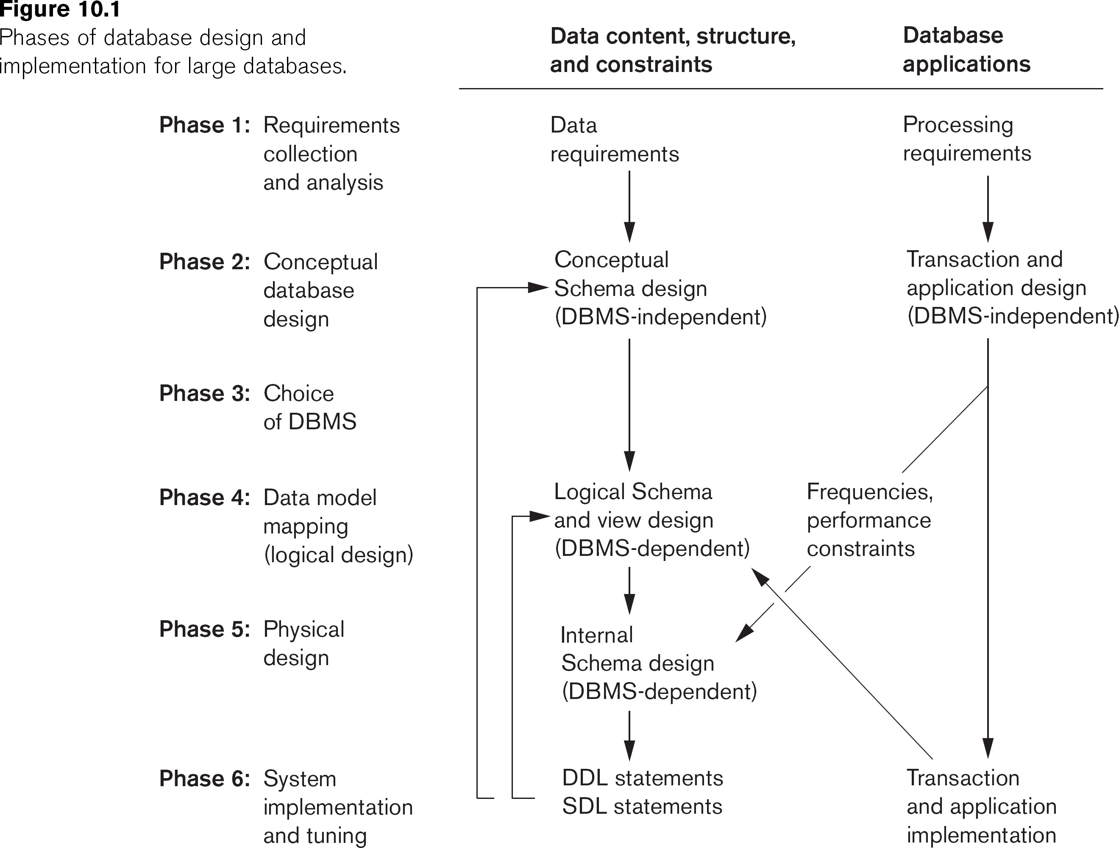
Database Design and Implementation Process

Slide 4
Goal of Conceptual Design
Description of data requirements that is…
Comprehensive
Entity types, relationships, and constraints
Sanity check of data & functional requirements
Reference for [unit/integration] testing/analysis
Concise/High-level
Easy to understand technically
Easy to communicate with non-technical users
Facilitates focus on data (vs. storage/implementation details)
Algorithmically Transformable
Improves application development efficiency, reduces errors

Slide 5
Entity-Relationship (ER) Model
Entity
Thing in the real world
Attribute
Property of an entity
Most of what we store in the database
Relationship
Association between sets of entities
Possibly with attribute(s)

Slide 6
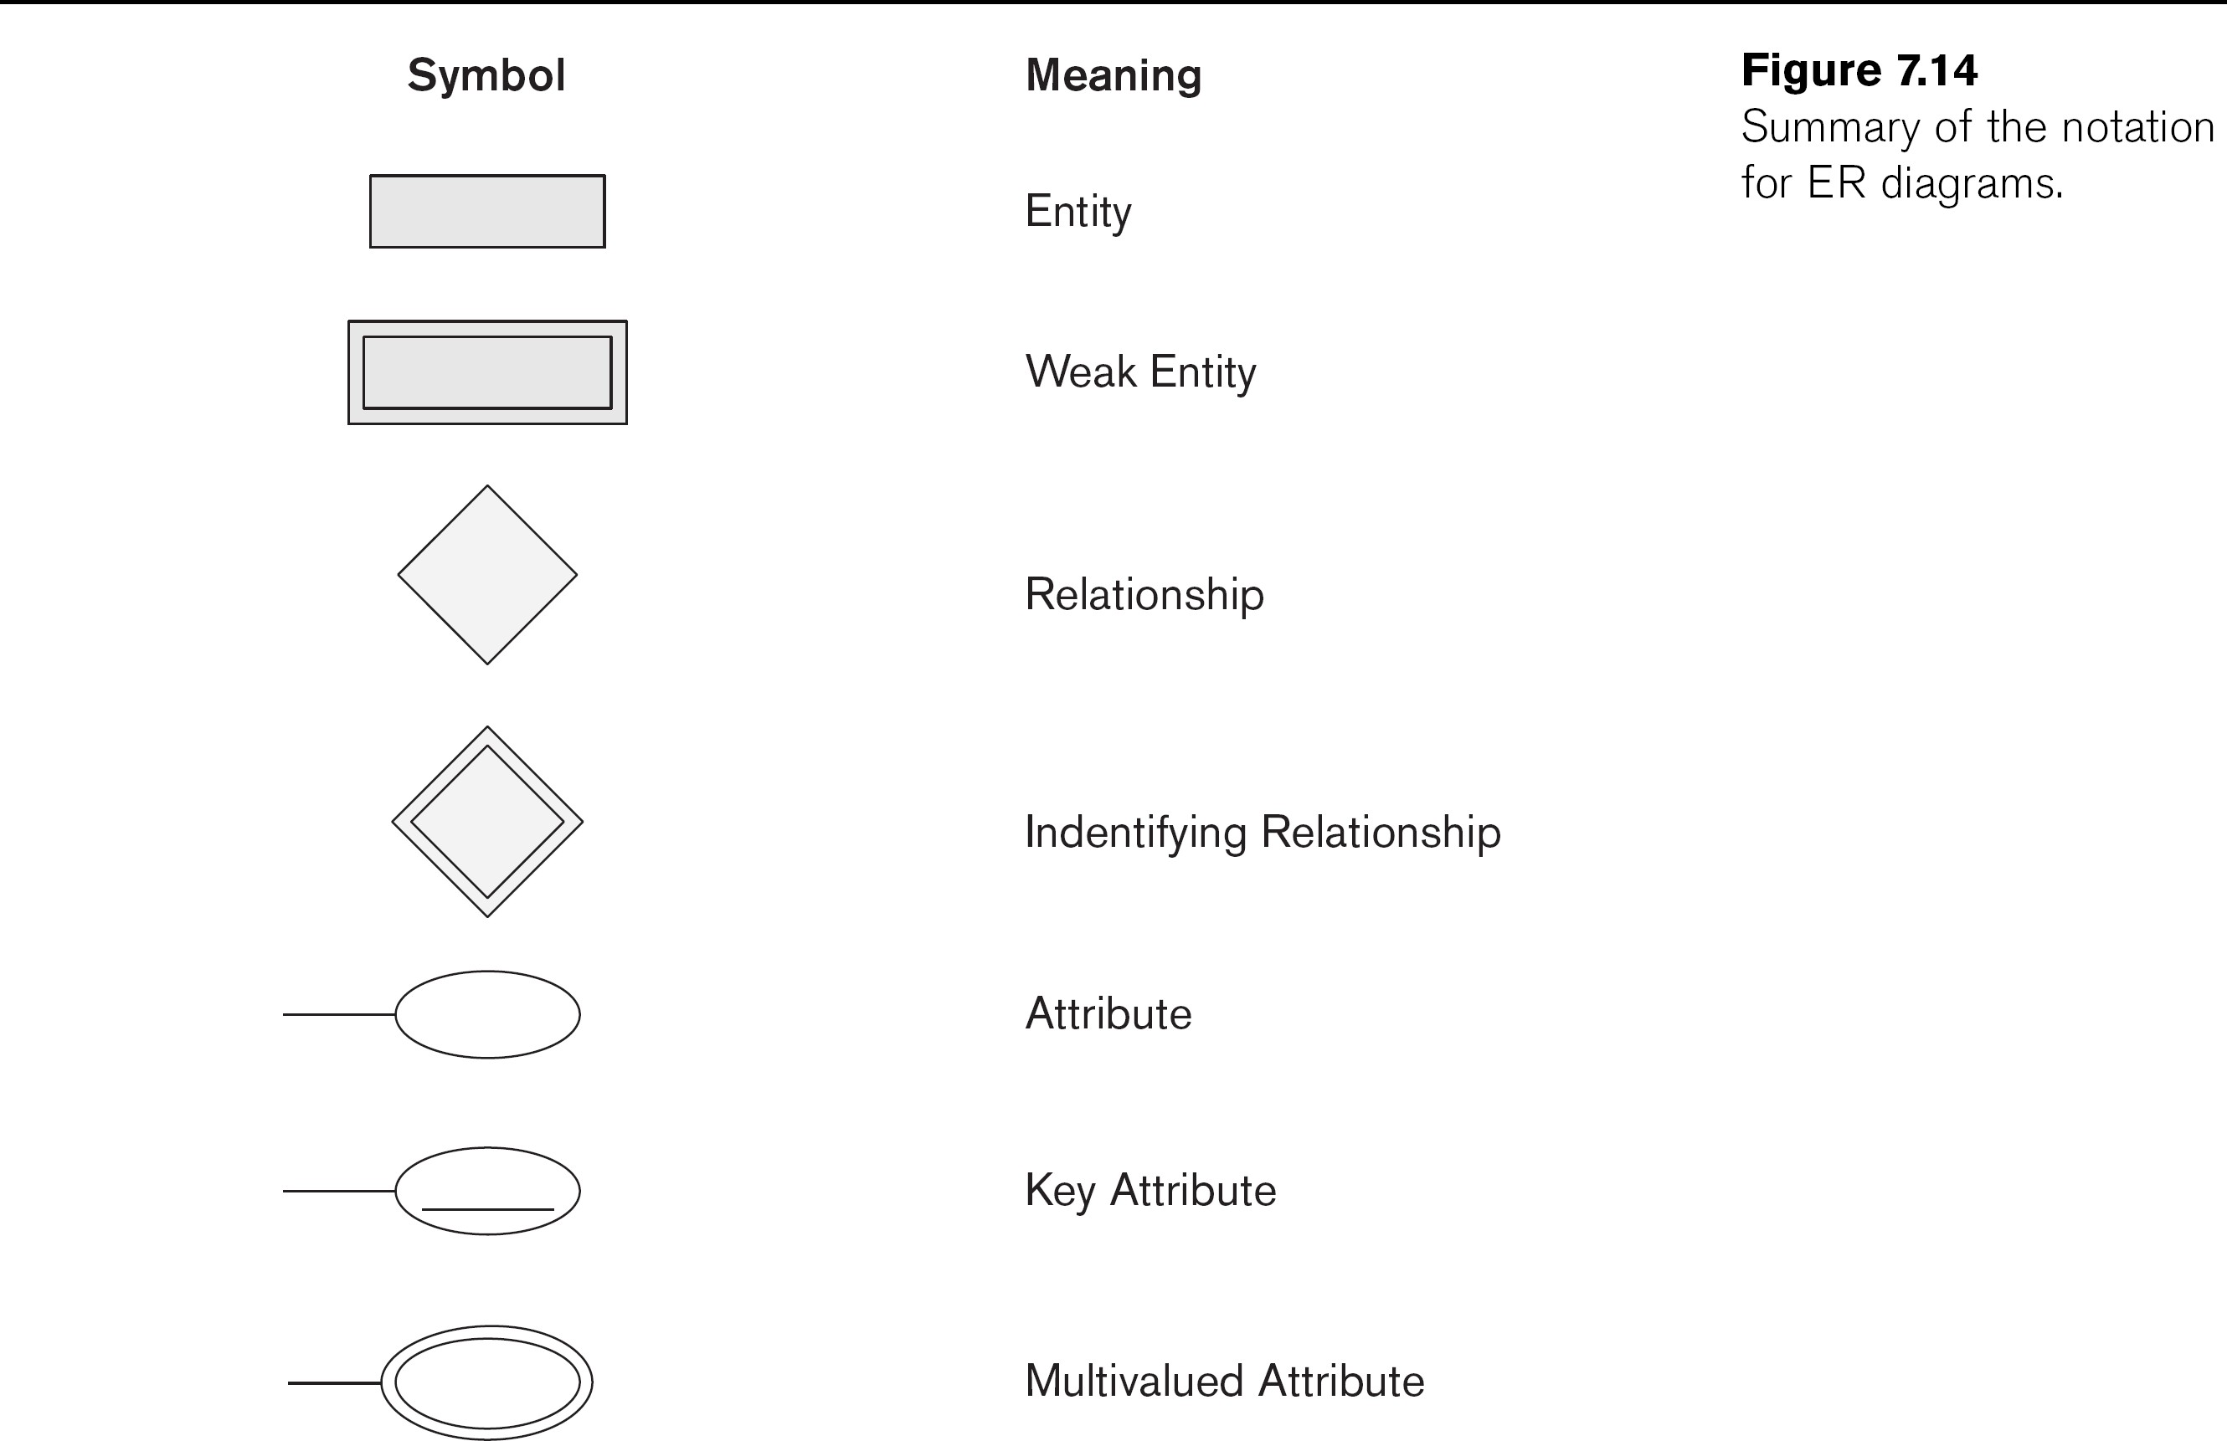
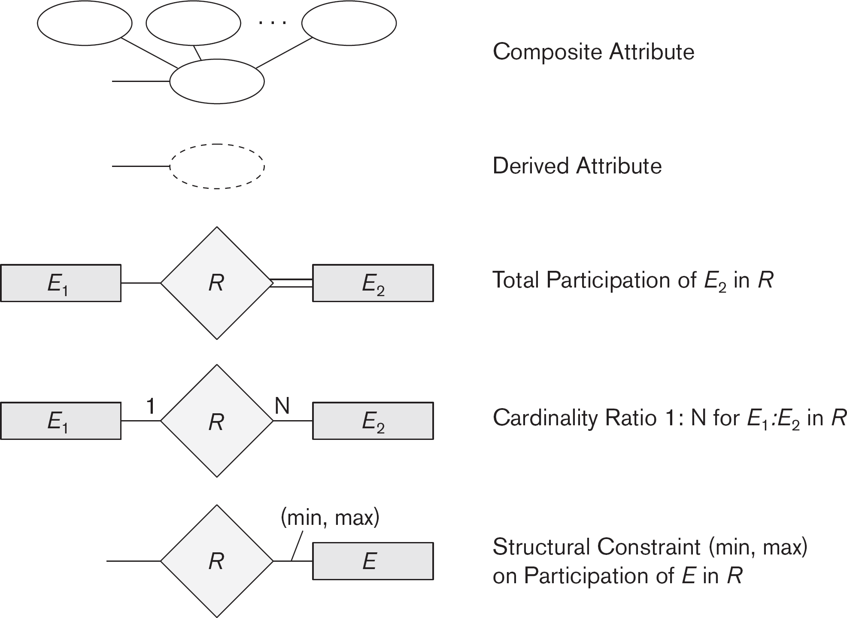
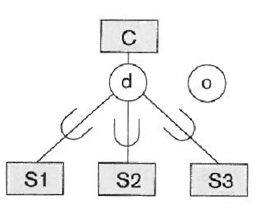
ER Diagrams
Graphical depiction of an ER model
Many notations, this class…
All cars have a year, age, make, model, registration (unique), vehicle number (vin; unique), some number of colors…
Specialization/Generalization

Slide 7
Entity Sets
Set of entities that have the same attributes
Make
Year
Model
All cars have a year, make, and model.
CAR

Slide 8
Composite Attributes
Can be subdivided into smaller subparts
Make
Year
Model
All cars have a year, make, model, and
registration.
CAR
Registration
State
Number

Slide 9
Multivalued Attributes
Can take a [possibly specified] number of values.
Make
Year
Model
CAR
Color
All cars have a year, make, model,
registration, and some
number of colors.
Registration
State
Number

Slide 10
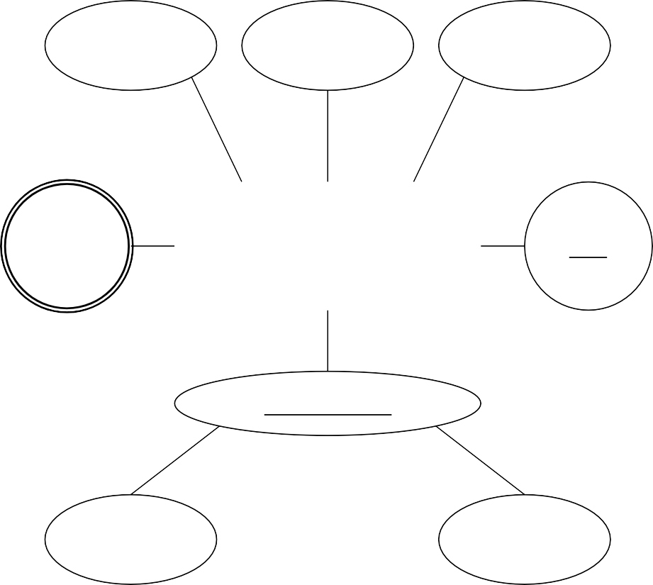
Key Attributes
The value uniquely
identifies each entity
Make
Year
Model
All cars have a year, make, model,
registration (unique), vehicle number (vin;
unique), some number of colors.
CAR
Color
CAR
VIN
Registration
State
Number

Slide 11

Potential Pitfall
In relational schema, underlining multiple attributes indicates that for all rows, the combination is unique
In ERDs, underlining multiple attributes indicates that each individually can
uniquely identify an entity

Slide 12
Derived Attributes
Age
The value can be computed
Make
Year
Model
All cars have a year,
age, make, model,
registration (unique), vehicle number (vin;
unique), some number of colors.
CAR
Color
VIN
Registration
State
Number

Slide 13
Exercise
Draw an ERD for the following description:
Each department has a unique name, a
unique number, and a particular employee who manages the department. We keep
track of the start date when that employee
began managing the department. A
department may have several locations.

Slide 14
Answer
Name
Number
DEPARTMENT
Location
Manager
Manager_ Start_Date

Slide 15
Exercise
Draw an ERD for the following description:
A department controls a number of projects, each of which has a unique name, a unique number, and a single location.

Slide 16
Answer
Name
Number
PROJECT
Location
Controlling_ Department

Slide 17
Exercise
Draw an ERD for the following description:
We store each employee’s name (first, last, MI),
Social Security number (SSN), street address, salary, sex (gender), and birth date. An employee is
assigned to one department, but may work on several projects, which are not necessarily controlled by the same department. We keep track of the
current number of hours per week that an employee
works on each project. We also keep track of the
direct supervisor of each employee (who is another employee).

Slide 18
Answer
Salary
SSN
Sex
Department
EMPLOYEE
Birthdate
Supervisor
Address
FName
Name
Works_On
Project
MI
LName
Hours

Slide 19
Exercise
Draw an ERD for the following description:
We want to keep track of the dependents of each employee for insurance purposes. We keep each dependent’s first name, sex, birth date, and relationship to the employee.

Slide 20
Answer
Sex
Employee
DEPENDENT
DBirthdate
Relationship
DName

Slide 21
Relationships
Associates one or more sets of entities
– One = recursive (role is important)
STUDENT
DEPT
CHAIR_F
All departments have a faculty member who serves as the chair. A faculty member can only chair one department.
FACULTY

Slide 22
Relationships
Associates one or more sets of entities
– One = recursive (role is important)
STUDENT
MAJOR_D
DEPT
CHAIR_F
All students must have a department in which they major.
FACULTY

Slide 23
Relationships
Associates one or more sets of entities
– One = recursive (role is important)
STUDENT
MAJOR_D
DEPT
MINOR_D
CHAIR_F
Students may have any number of departments in which they minor.
FACULTY

Slide 24
Relationships
Associates one or more sets of entities
– One = recursive (role is important)
STUDENT
MAJOR_D
DEPT
MINOR_D
Tutor
Tutee
TUTORS
CHAIR_F
Students can tutor other student(s).
FACULTY

Slide 25
Cardinality Ratios
Constrains the number of entities that can participate in each role of the relationship
STUDENT
MAJOR_D
DEPT
 | 1
MINOR_D
Tutor
Tutee
TUTORS
CHAIR_F
All departments have a faculty member who serves as the chair. A faculty member can only chair one department.
 | 1
FACULTY

Slide 26
Cardinality Ratios
Constrains the number of entities that can participate in each role of the relationship
N 1
STUDENT
MAJOR_D
DEPT
 | 1
MINOR_D
Tutor
Tutee
TUTORS
CHAIR_F
All students must have a department in which they major.
 | 1
FACULTY

Slide 27
Cardinality Ratios
Constrains the number of entities that can participate in each role of the relationship
N 1
STUDENT
MAJOR_D
DEPT
 | 1
N M
Tutee
MINOR_D
Tutor
TUTORS
CHAIR_F
Students may have any number of departments in which they minor.
 | 1
FACULTY

Slide 28
Cardinality Ratios
Constrains the number of entities that can participate in each role of the relationship
N 1
STUDENT
MAJOR_D
DEPT
 | 1
N
Tutee M
M
MINOR_D
Tutor N
TUTORS
CHAIR_F
Students can tutor other student(s).
 | 1
FACULTY

Slide 29
Structural Constraints
If an entity does not exist unless it appears with an entity in a relationship, the participation is total (existence dependency). Else, partial.
N 1
STUDENT
MAJOR_D
DEPT
 | 1
N
Tutee M
M
MINOR_D
Tutor N
TUTORS
CHAIR_F
All departments have a faculty member who serves as the chair. A faculty member can only chair one department.
 | 1
FACULTY

Slide 30
Structural Constraints
If an entity does not exist unless it appears with an entity in a relationship, the participation is total (existence dependency). Else, partial.
N 1
STUDENT
MAJOR_D
DEPT
 | 1
N
Tutee M
M
MINOR_D
Tutor N
TUTORS
CHAIR_F
All students must have a department in which they major.
 | 1
FACULTY

Slide 31
Attributes of Relationships
1->1, can go to either entity 1->N, can go to (1) entity
N 1
STUDENT
MAJOR_D
DEPT
 | 1
N
Tutee M
M
MINOR_D
Tutor N
TUTORS
Office
CHAIR_F
 | 1
FACULTY
Each department chair has an office.

Slide 32
Attributes of Relationships
1->1, can go to either entity 1->N, can go to (1) entity
Done
N 1
STUDENT
MAJOR_D
DEPT
 | 1
N
Tutee M
M
MINOR_D
Tutor N
TUTORS
Office
CHAIR_F
 | 1
FACULTY
It is important to know whether or not a student has completed his/her major.

Slide 33
Attributes of Relationships
1->1, can go to either entity 1->N, can go to (1) entity
Done
N 1
STUDENT
MAJOR_D
DEPT
 | 1
N
Tutee M
M
MINOR_D
Tutor N
TUTORS
Done
Office
CHAIR_F
 | 1
FACULTY
It is important to know whether or not a student has completed each of his/her minor(s).

Slide 34
Attributes of Relationships
1->1, can go to either entity 1->N, can go to (1) entity
Done
N 1
STUDENT
MAJOR_D
DEPT
 | 1
N
Tutee M
M
MINOR_D
Tutor N
TUTORS
Done
Office
CHAIR_F
Subject
It is important to know the subject(s) in which a tutee is being tutored by each tutor.
 | 1
FACULTY

Slide 35
Weak Entities
Entity types that do not have key attributes
of their own are weak; instead identified by relation to specific entity of another type
(the identifying type)
Prof
COURSE |  | 1
N
SECTION
COURSE SEC
SECTION
NAME
Number
Book
DEPT
NUM

Slide 36
Revise!
We store each employee’s name (first, last, MI), Social
Security number (SSN), street address, salary, sex (gender), and birth date. An employee is
assigned to one department, but may work on several
projects, which are not
Salary
SSN
Sex
necessarily controlled by the same department. We keep
track of the current number of
hours per week that an
employee works on each
project. We also keep track of the direct supervisor of each employee (who is
another employee).
Department
EMPLOYEE
Birthdate
Supervisor
Address
FName
Name
Works_On
Project
MI
LName
Hours

Slide 37
Answer
Salary
SSN
Sex
Department
1
Supervisor
Birthdate
Supervision
EMPLOYEE
Supervisee
Address
N
FName
Name
Works_On
Project
MI
LName
Hours

Slide 38
Revise!
We want to keep track
Salary
SSN
Sex
Department
of the dependents of each employee for
insurance purposes. We
keep each dependent’s first name, sex, birth
date, and relationship to the employee.
1
Supervision
Supervisor
EMPLOYEE
Birthdate
Supervisee
Address
N
FName
Name
Works_On
Project
MI
LName
Hours
Sex
Employee
DEPENDENT
DBirthdate
Rela7onship
DName

Slide 39
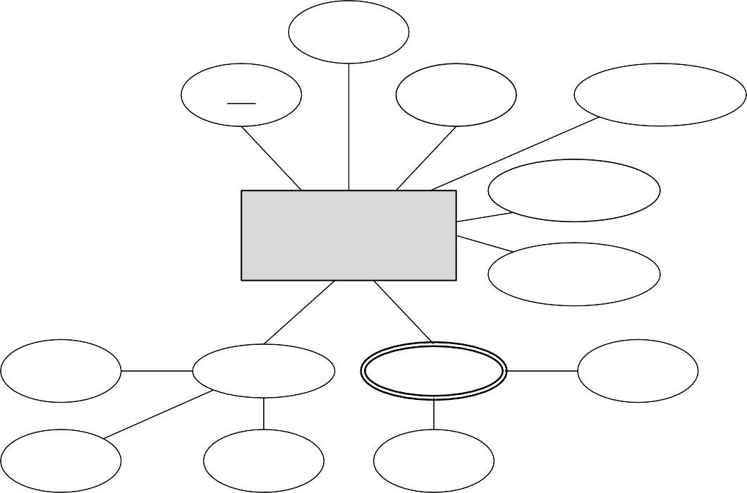
Answer
Salary
SSN
Sex
Department
1
Supervisor
Birthdate
Supervision
EMPLOYEE
Supervisee
Address
N
1
FName
Name
Works_On
Project
Sex
MI
LName
Hours
N
DEPENDENT
DEPENDENT
_OF
DBirthdate
Relationship
DName

Slide 40
Revise!
A department controls
a number of projects, each of which has a
unique name, a unique number, and a single
location.
Name
Number
PROJECT
Loca%on
Controlling_ Department
Name
Number
DEPARTMENT
Loca%on
Manager
Manager_ Start_Date

Slide 41
Answer
Name
Number
PROJECT
Location
N
Name
Number
1
DEPARTMENT
CONTROLS
Manager
Location
Manager_ Start_Date

Slide 42
Revise!
Each department has a … particular employee who manages the department.
Name
Number
Loca%on
PROJECT
N
Name
Number
An employee is assigned to one department, but may work on several
projects, which are not necessarily controlled by
the same department. We keep track of the current number of hours per
week that an employee works on each project.
CONTROLS
1
DEPARTMENT
Manager
Loca%on
Manager_ Start_Date
Salary
SSN
Sex
Department
1
Supervisor
Birthdate
Supervision
EMPLOYEE
N
Supervisee
1
Address
FName
Name
Works_On
Project
MI
LName
Hours
Sex
DEPENDENT
_OF
N
DEPENDENT
DBirthdate
RelaIonship
DName

Slide 43
Answer
Supervisor
1
Supervisee
N
Hours
Supervision
M
EMPLOYEE
WORKS_ON
SSN
Name
1 N
Start
_Date
N
PROJECT
Location
Manages
N
Number
1
1
DEPARTMENT
1
CONTROLS
Works_For
Location
Name
Number

Slide 44
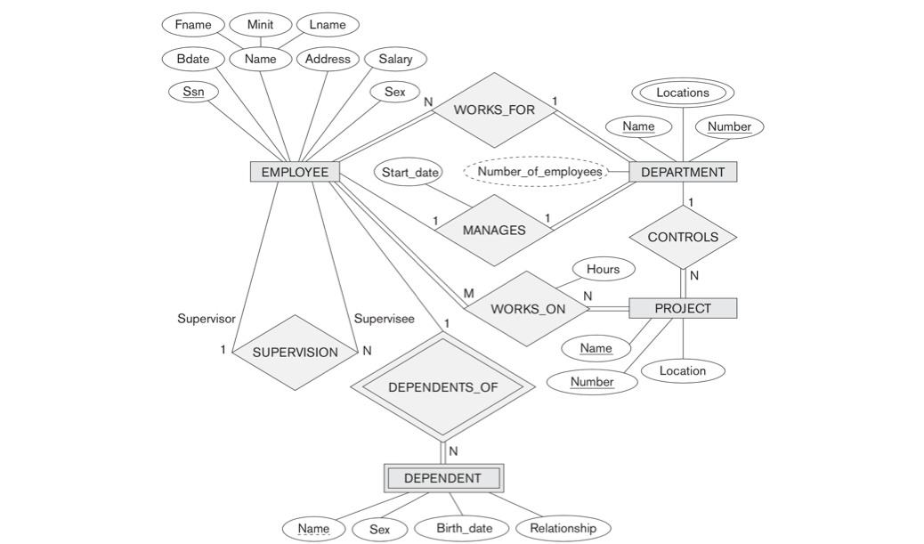
All Together Now!

Slide 45
Specialization/Generalization
Only a subset of entities within a type have certain attributes or participate in certain
relationships
ID
STUDENT
U
GRAD_STUDENT
Degrees

Slide 46
Multiple Subtypes: Disjointedness
(o)verlap: may be more than one
(d)isjoint: entities may only be one subtype
SSN
A person can be an employee, an alumnus, and/or a student
PERSON
o
U
U
U
EMPLOYEE
ALUMNUS
STUDENT

Slide 47
Multiple Subtypes: Disjointedness
(o)verlap: may be more than one
(d)isjoint: entities may only be one subtype
SSN
A person can be either an employee, an alumnus, or a student
PERSON
d
U
U
U
EMPLOYEE
ALUMNUS
STUDENT

Slide 48
Multiple Subtypes: Completeness
Similar to relationships; can be total (must belong to subtypes) or partial (can belong)
SSN
A person must be exactly one: an employee, an alumnus, or a student
PERSON
d
U
U
U
EMPLOYEE
ALUMNUS
STUDENT

Slide 49
Exercise
The database keeps track of three types of persons: employees, alumni, and students. A person can belong to one, two, or all three of these types. Each person has a name, SSN, sex, address, and birth date.
Every employee has a salary, and there are three types of employees: faculty, staff, and student assistants. Each employee belongs to exactly one of these types. For each
alumnus, a record of the degree or degrees that he or she earned at the university is kept, including the name of the degree, the year granted, and the major department. Each
student has a major department.
Each faculty has a rank, whereas each staff member has a staff position. Student
assistants are classified further as either research assistants or teaching assistants, and the percent of time that they work is recorded in the database. Research assistants have their research project stored, whereas teaching assistants have the current course they work on.
Students are further classified as either graduate or undergraduate, with the specific attributes degree program (M.S., Ph.D., M.B.A., and so on) for graduate students and class (freshman, sophomore, and so on) for under- graduates.

Slide 50
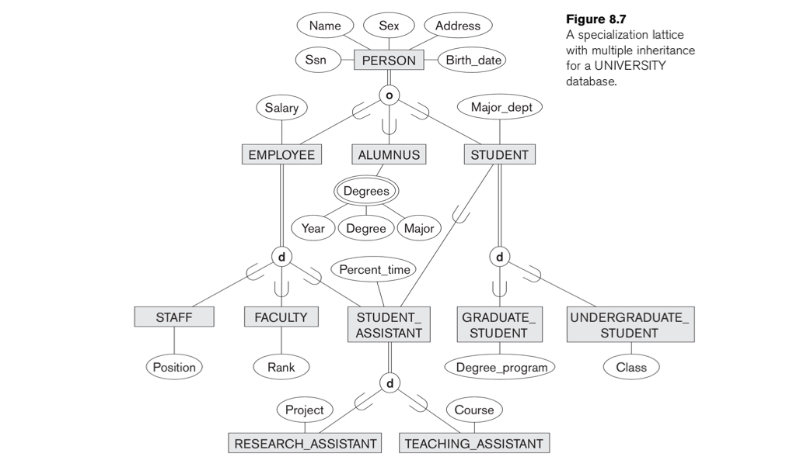
Answer

Slide 51
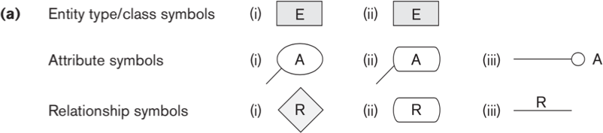
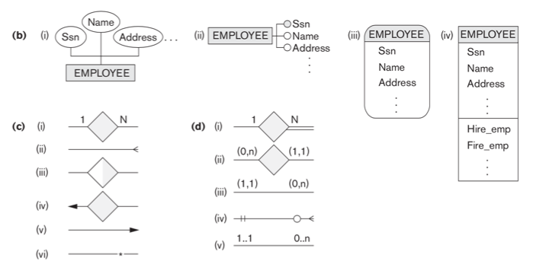
Alternative Notation (1)
Figure A. 1

Slide 52
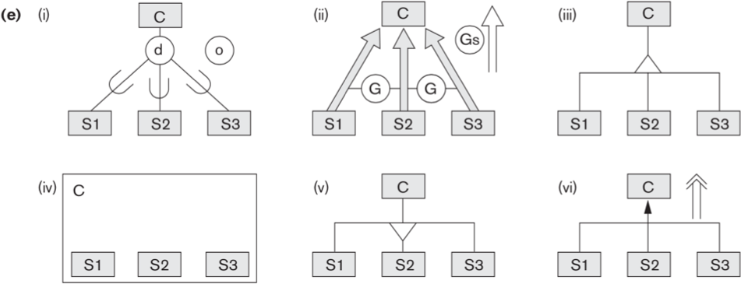
Alternative Notation (2)
Figure A. 1

Slide 53
Requirements Elicitation
The conceptual model should inform requirements elicitation questions:
What are the main kinds of objects to be stored in the database (entity types)?
For each object, what information should be stored (attributes,
relationships)? What information distinguishes one object of a type from another (keys, weak entities)? Are there different
kinds/categories of objects (specialization/generalization)?
For each piece of information, what characterizes a valid value (composite/multi-valued, structural, etc.)?
For related objects x and y, can x exist without y (participation)? How many x’s can a y have, and vice-versa (cardinality)?

Slide 54
Approaches to Conceptual Design
Centralized
Single authority responsible for merging requirements into schema
Reasonable for smaller applications
View Integration
Each stakeholder implements local view
Individual views integrated into global schema
Individual views can be reconstructed as external schemas after integration

Slide 55
View Integration (1)
Identify correspondences and conflicts
– Conflicts: names, types, domain, constraints
Modify views to conform
Merge
Restructure

Slide 56
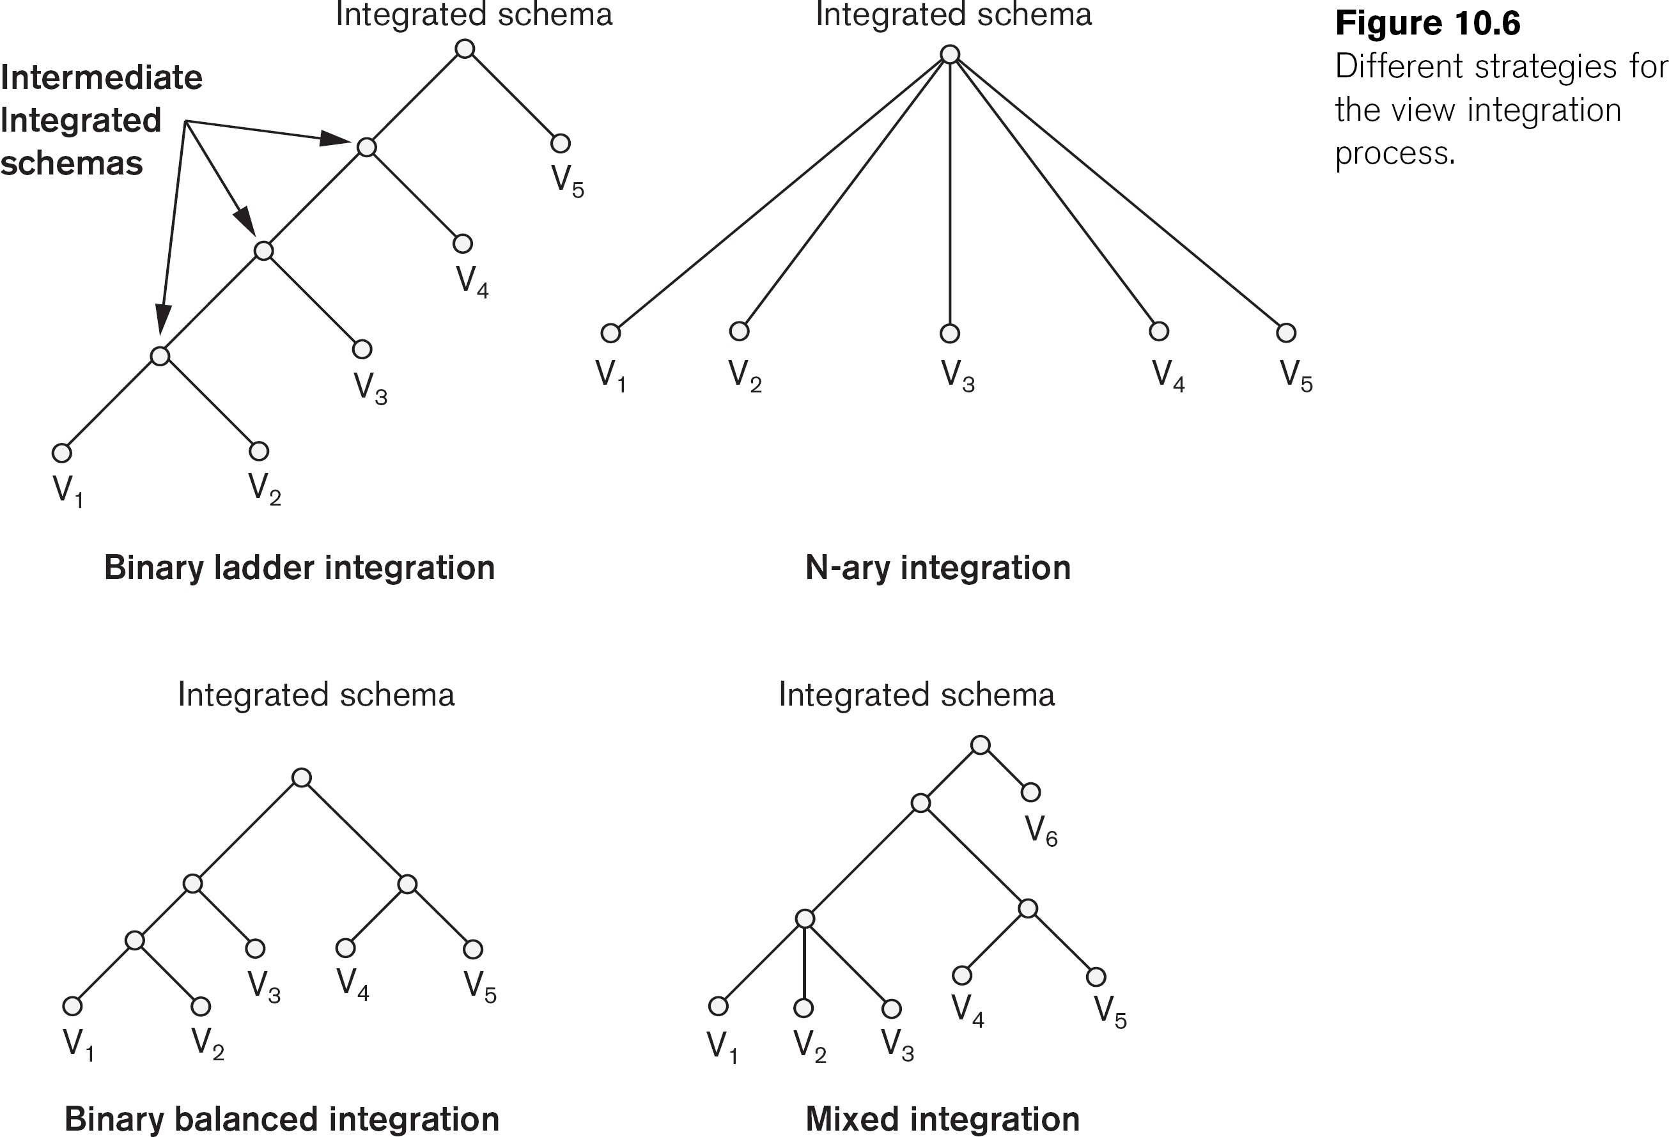
View Integration (2)

Slide 57
Summary
The goal of conceptual design is to develop a set of data requirements that are comprehensive,
clear & easy to understand, and algorithmically transformable
ER Diagrams (ERDs) are one such design model that visually represent the entities, attributes,
and relationships of a system
Requirements elicitation and conceptual design is an iterative process that is a necessary
prerequisite to implementing a database

Slide 58
Ex. 1 Design ER Diagram:
Assume we have the following application that models soccer teams, the games they play, and the players in each team. In the design, we want to capture the following:
We have a set of teams, each team has an ID (unique identifier), name, main stadium, and to which city this team belongs.
Each team has many players, and each player belongs to one team. Each player has a number (unique identifier), name, DoB, start year, and shirt number that he uses.
Teams play matches, in each match there is a host team and a guest team. The match takes place in the stadium of the host team.
For each match we need to keep track of the following:
The date on which the game is played
The final result of the match
The players participated in the match. For each player, how many goals he scored, whether or not he took yellow card, and whether or not he took red card.
During the match, one player may substitute another player. We want to capture this substitution and the time at which it took place.
Each match has exactly three referees. For each referee we have an ID (unique identifier), name, DoB, years of experience. One referee is the main referee and the other two are assistant referee.
Design an ER diagram to capture the above requirements. State any assumptions you have that affects your design (use the back of the page if needed). Make sure cardinalities and primary keys are clear.

Slide 59
Ex. 2 Design ER Diagram:
Production tracking is important in many manufacturing environments (e.g., the pharmaceuticals industry, children’s toys, etc.). The following ER diagram captures important information in the tracking of production. Specifically, the ER diagram captures relationships between production lots (or batches), individual production units, and raw materials.

